Slide 1
The Lake Washington Sediment Record Revisited
Long-term Trends in Lake Eutrophication Indicators
Curtis DeGasperi¹ and Will Hobbs²
¹King County Science and Technical Support Section
²Washington State Department of Ecology
Notes:
Open by saying

Slide 2

Value proposition
Father Nicolaus Steno
Lake Sediment Cores
Long and consistent data sets with less effort
  Shout out to Father Nicolas Steno (Niels Steensen) (1638-1686)!
    Law of superposition
    Principle of original horizontality
    Principle of lateral continuity
https://en.wikipedia.org/wiki/Stratigraphy
Notes:
We are often asked whether things are getting better or getting worse over time – i.e., long-term trends
What if I told you that you could evaluate trends over a 100 or more years?
…and you wouldn’t have to worry about changes in sampling or laboratory methods or shifting baselines?
I also want you to consider that lake sediments are a kind of low pass filter that integrates inputs from the entire watershed (and airshed).
While the Washington State Department of Ecology recognized long ago the value of sediment coring, King County has not been so easily convinced.
Niels Stensen – Danish aka Titular Bishop of Titiopolis. Beatified in 1988 by Pope John Paul II. Died just as the Enlightenment was starting to take off.
Father Nicholas proposed the radical theory that sediments were laid down in horizontal layers so that the deepest layers were the oldest and that these layers could extend for some distance in all directions.

Slide 3
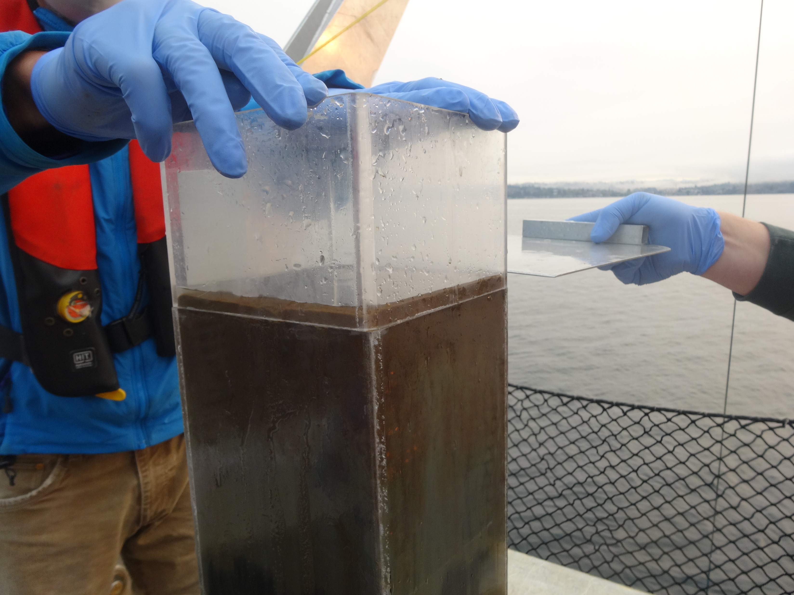
Question?
What can the collection and analysis of an age-dated sediment core from Lake Washington tell us about its history of eutrophication and recovery?
Notes:
What can the collection and analysis of an age-dated sediment core from Lake Washington tell us about its history of eutrophication?
Lake Washington has a well-documented history of eutrophication and recovery following diversion of treated wastewater inputs in the 1960s. Much of this work was conducted under the direction of Dr. W.T. Edmondson at the University of Washington.

Slide 4
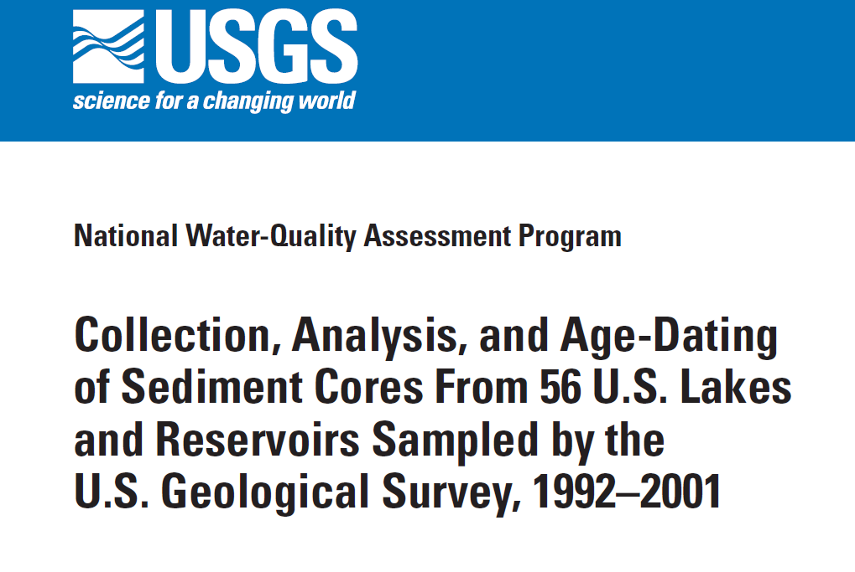
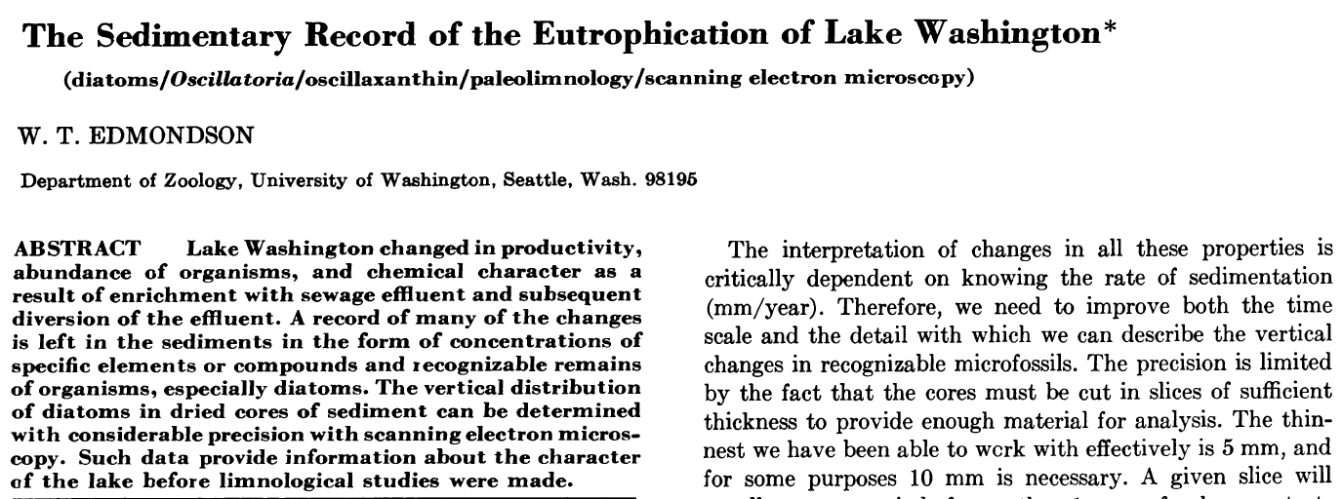
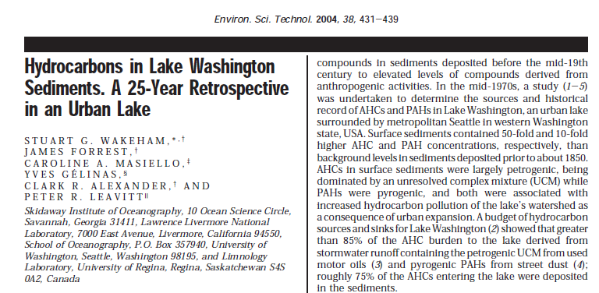
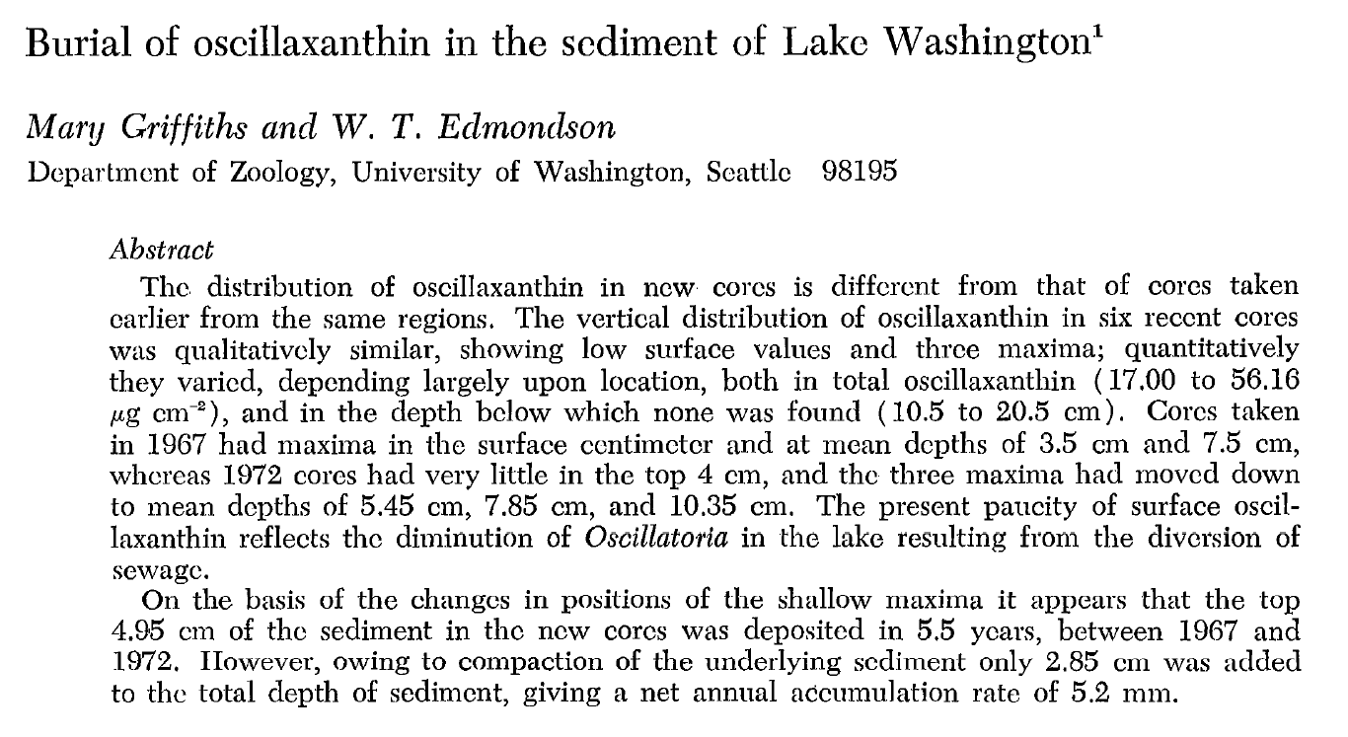
Many previous coring studies
Notes:
In addition to long-term water quality monitoring data, there have also been many previous sediment coring studies.
Conducting a pilot study in this well studied lake meant that there would be a wealth of independent data that could be used to validate our results.

Slide 5
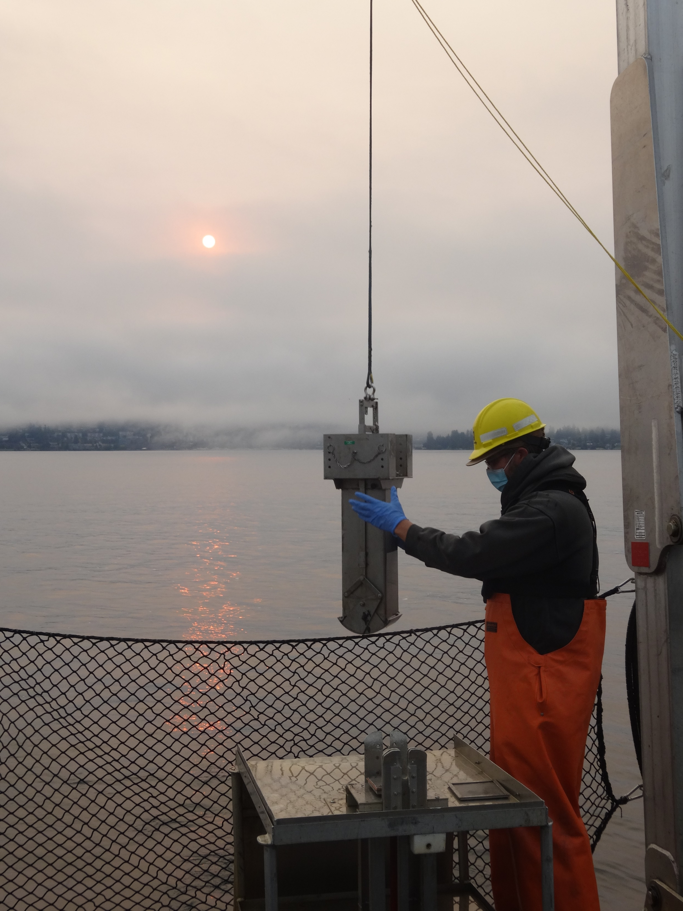
Lake Washington sediment coring pilot study
40 cm core collected in September 2020
Collaboration with:
  Core dating - Science Museum of Minnesota (Dan Engstrom)
  Algal pigments - University of Alberta (Rolf Vinebrooke)
  C/N/isotopes - Washington State University (Ben Harlow)
Box core, sectioning equipment, and field assistance provided by Ecology (Will Hobbs, Callie Mathieu)
King Co. Environmental Lab contribution: field support, laboratory (%Solids, %LOI, phosphorus, cyanotoxins, metals, PCB homologs)
Notes:
I’ll emphasize that this was a pilot study – an attempt to demonstrate to King County management that these types of studies produce useful and reliable long-term trend data.
We collected a 40 cm core in September 2020.
Read off contributions…

Slide 6
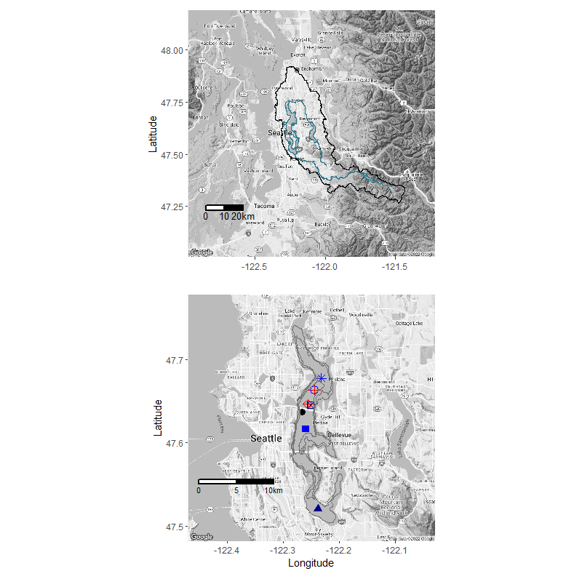
Coring location
Notes:
Map on left showing location of Lake Washington and its drainage basin in relation to Seattle and Puget Sound. Map on right shows the locations of historical coring sites and the location where our core was collected. The coring location was a bit north of the State Route 520 floating bridge. Note that this location was also cored by US Geological Survey in 1998.

Slide 7
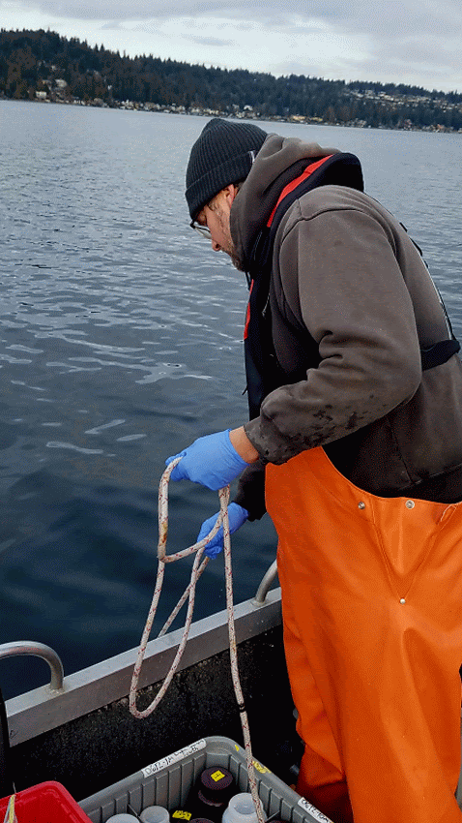
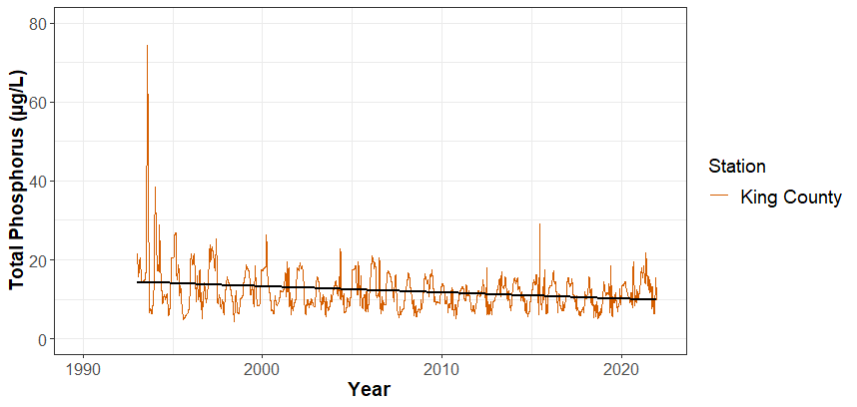
Lake Washington TP trends 1993-2021
0852
Notes:
A digression to illustrate the potential limitations of “long-term” water quality monitoring data sets. Here is a plot of the average surface layer TP from King County’s program that started sampling the open waters of Lake Washington in 1993 - 29 year’s worth of monthly to twice monthly data through 2021.

Slide 8
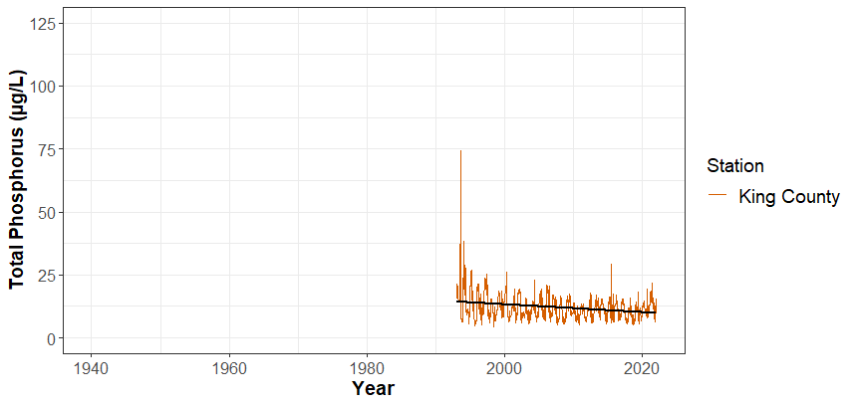
Lake Washington TP trends 1993-2021
0852
Notes:
Just expanding the x axis

Slide 9
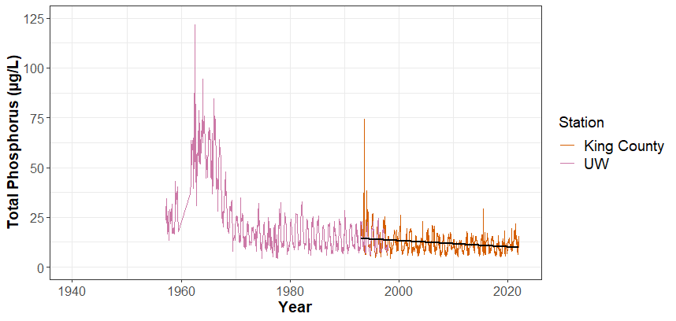
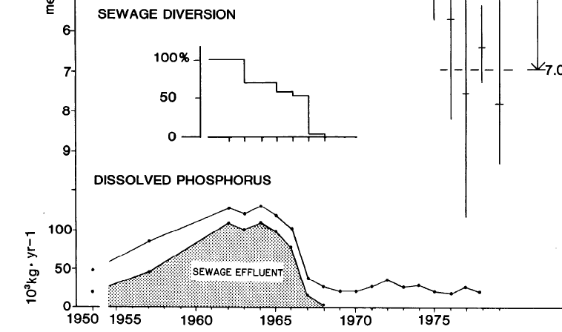
Lake Washington TP trends 1957-2021
0852
UW – University of Washington TP data courtesy of Daniel Schindler
Edmondson and Litt (Limnol. Oceanogr. 1982)
Notes:
Fortunately, the University of Washington routinely measured water column total phosphorus …for a period in the 1950s and then systematically beginning in the early 1960s through the 1990s. We can now see that the early King County TP data is suspect, and we have a much clearer picture of the lake response to the period of treated wastewater input and subsequent diversion.
Details here about wastewater inputs…secondary wastewater treatment inputs to Lake Washington began with one plant in 1941 and expanded to 11 WWTPs by the 1960s. Following the formation of a regional wastewater utility, METRO, all treated wastewater was diverted from the lake by 1968.
Lesser quantities of raw sewage were discharged to Lake Washington from Seattle starting around 1900, which was later joined by inputs from Renton and Kirkland. A Seattle bond measure in 1926 resulted in the first diversion project which was completed by 1936. From this point forward, raw wastewater inputs were replaced with treated wastewater discharges.

Slide 10
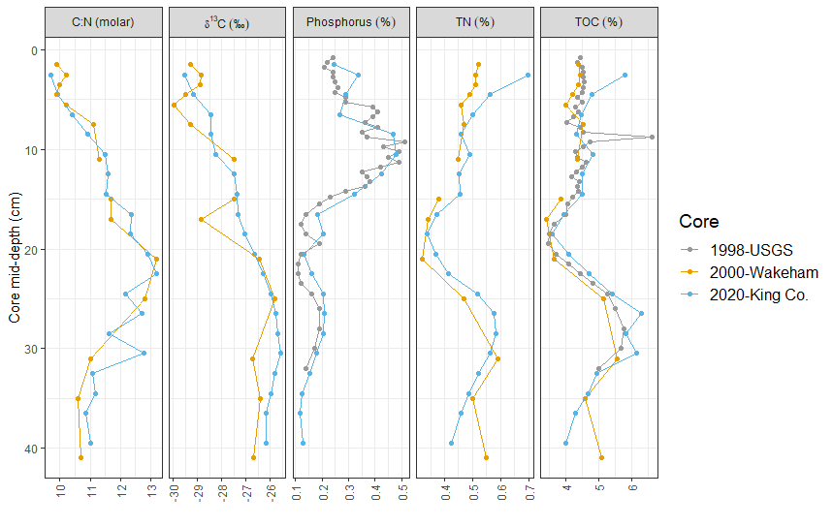
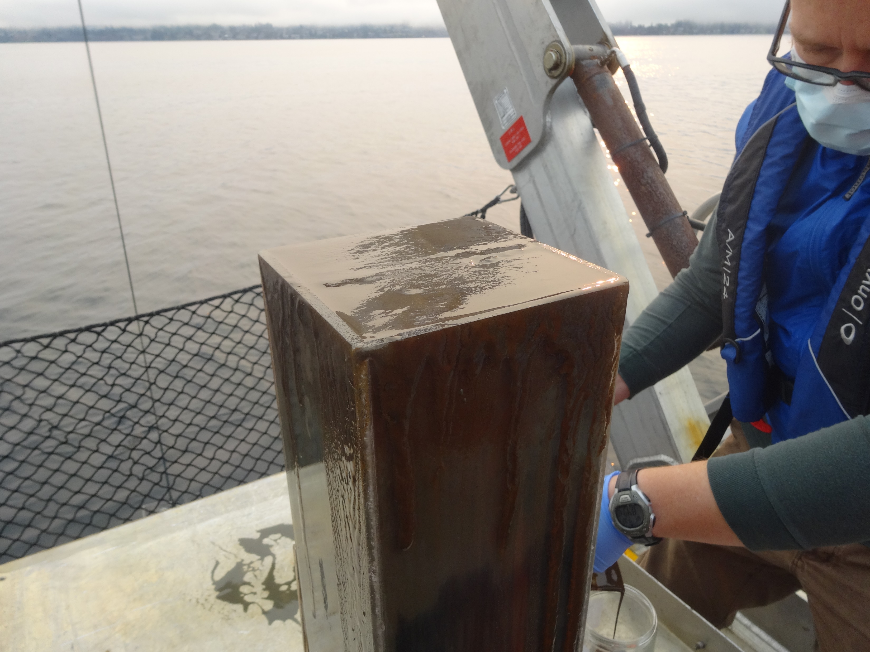
Results consistent with previous coring work
Notes:
Not every parameter was measured in previous studies, but the data for carbon, nitrogen, and phosphorus were very consistent with previous coring studies. Which illustrates that the sediment records are well preserved and that they can be consulted when needed.

Slide 11
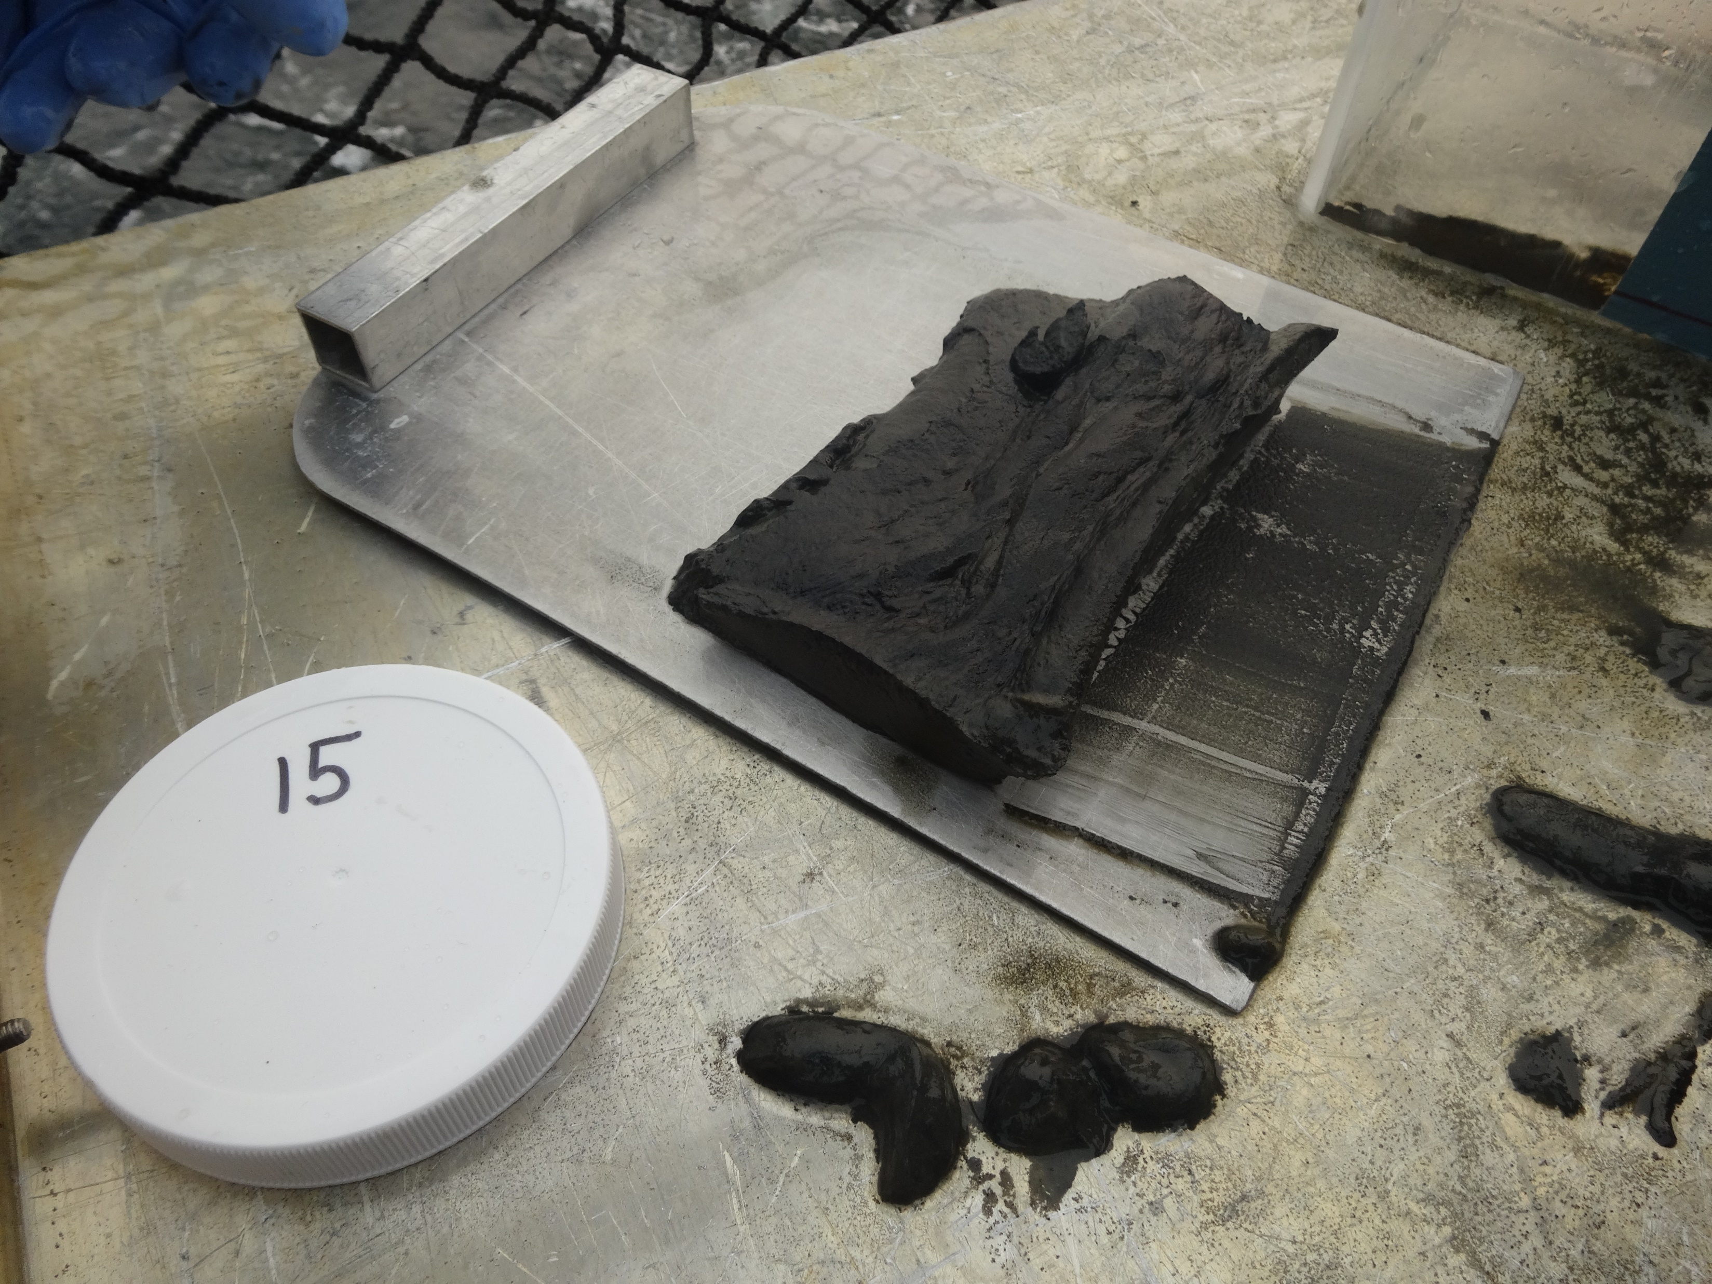
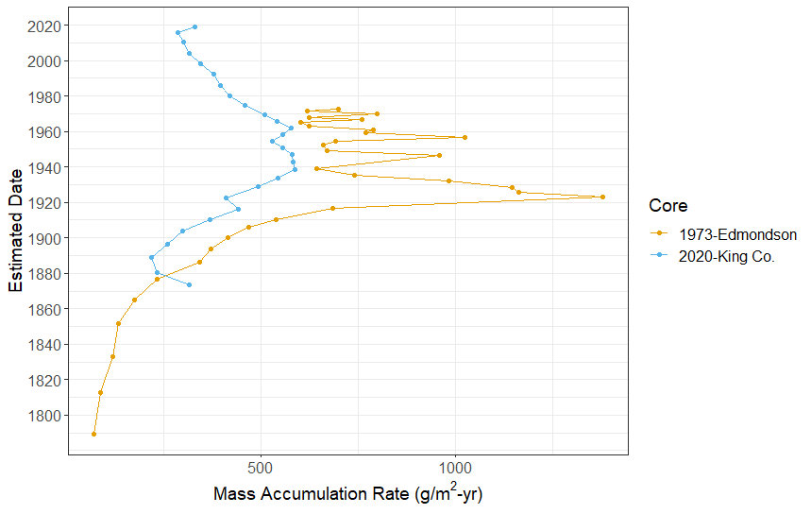
Sediment Mass Accumulation Rate
Notes:
Estimated mass accumulation rates were also generally consistent with earlier studies….Edmondson core collected from different location – deep area off Madison Park just south of the SR520 bridge. Generally, basin erosion didn’t increase in response to logging of the watershed, which was mostly completed by 1900…but rather it was road building associated with the expansion of development around the lake that resulted in an initial increase in soil erosion and then a decrease in response to stabilization of watershed soils.

Slide 12
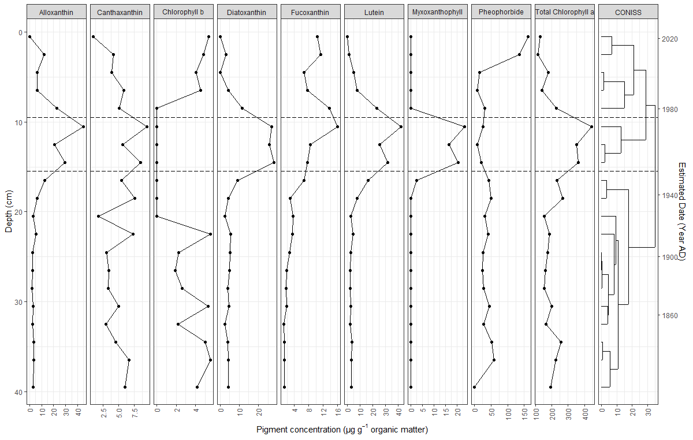
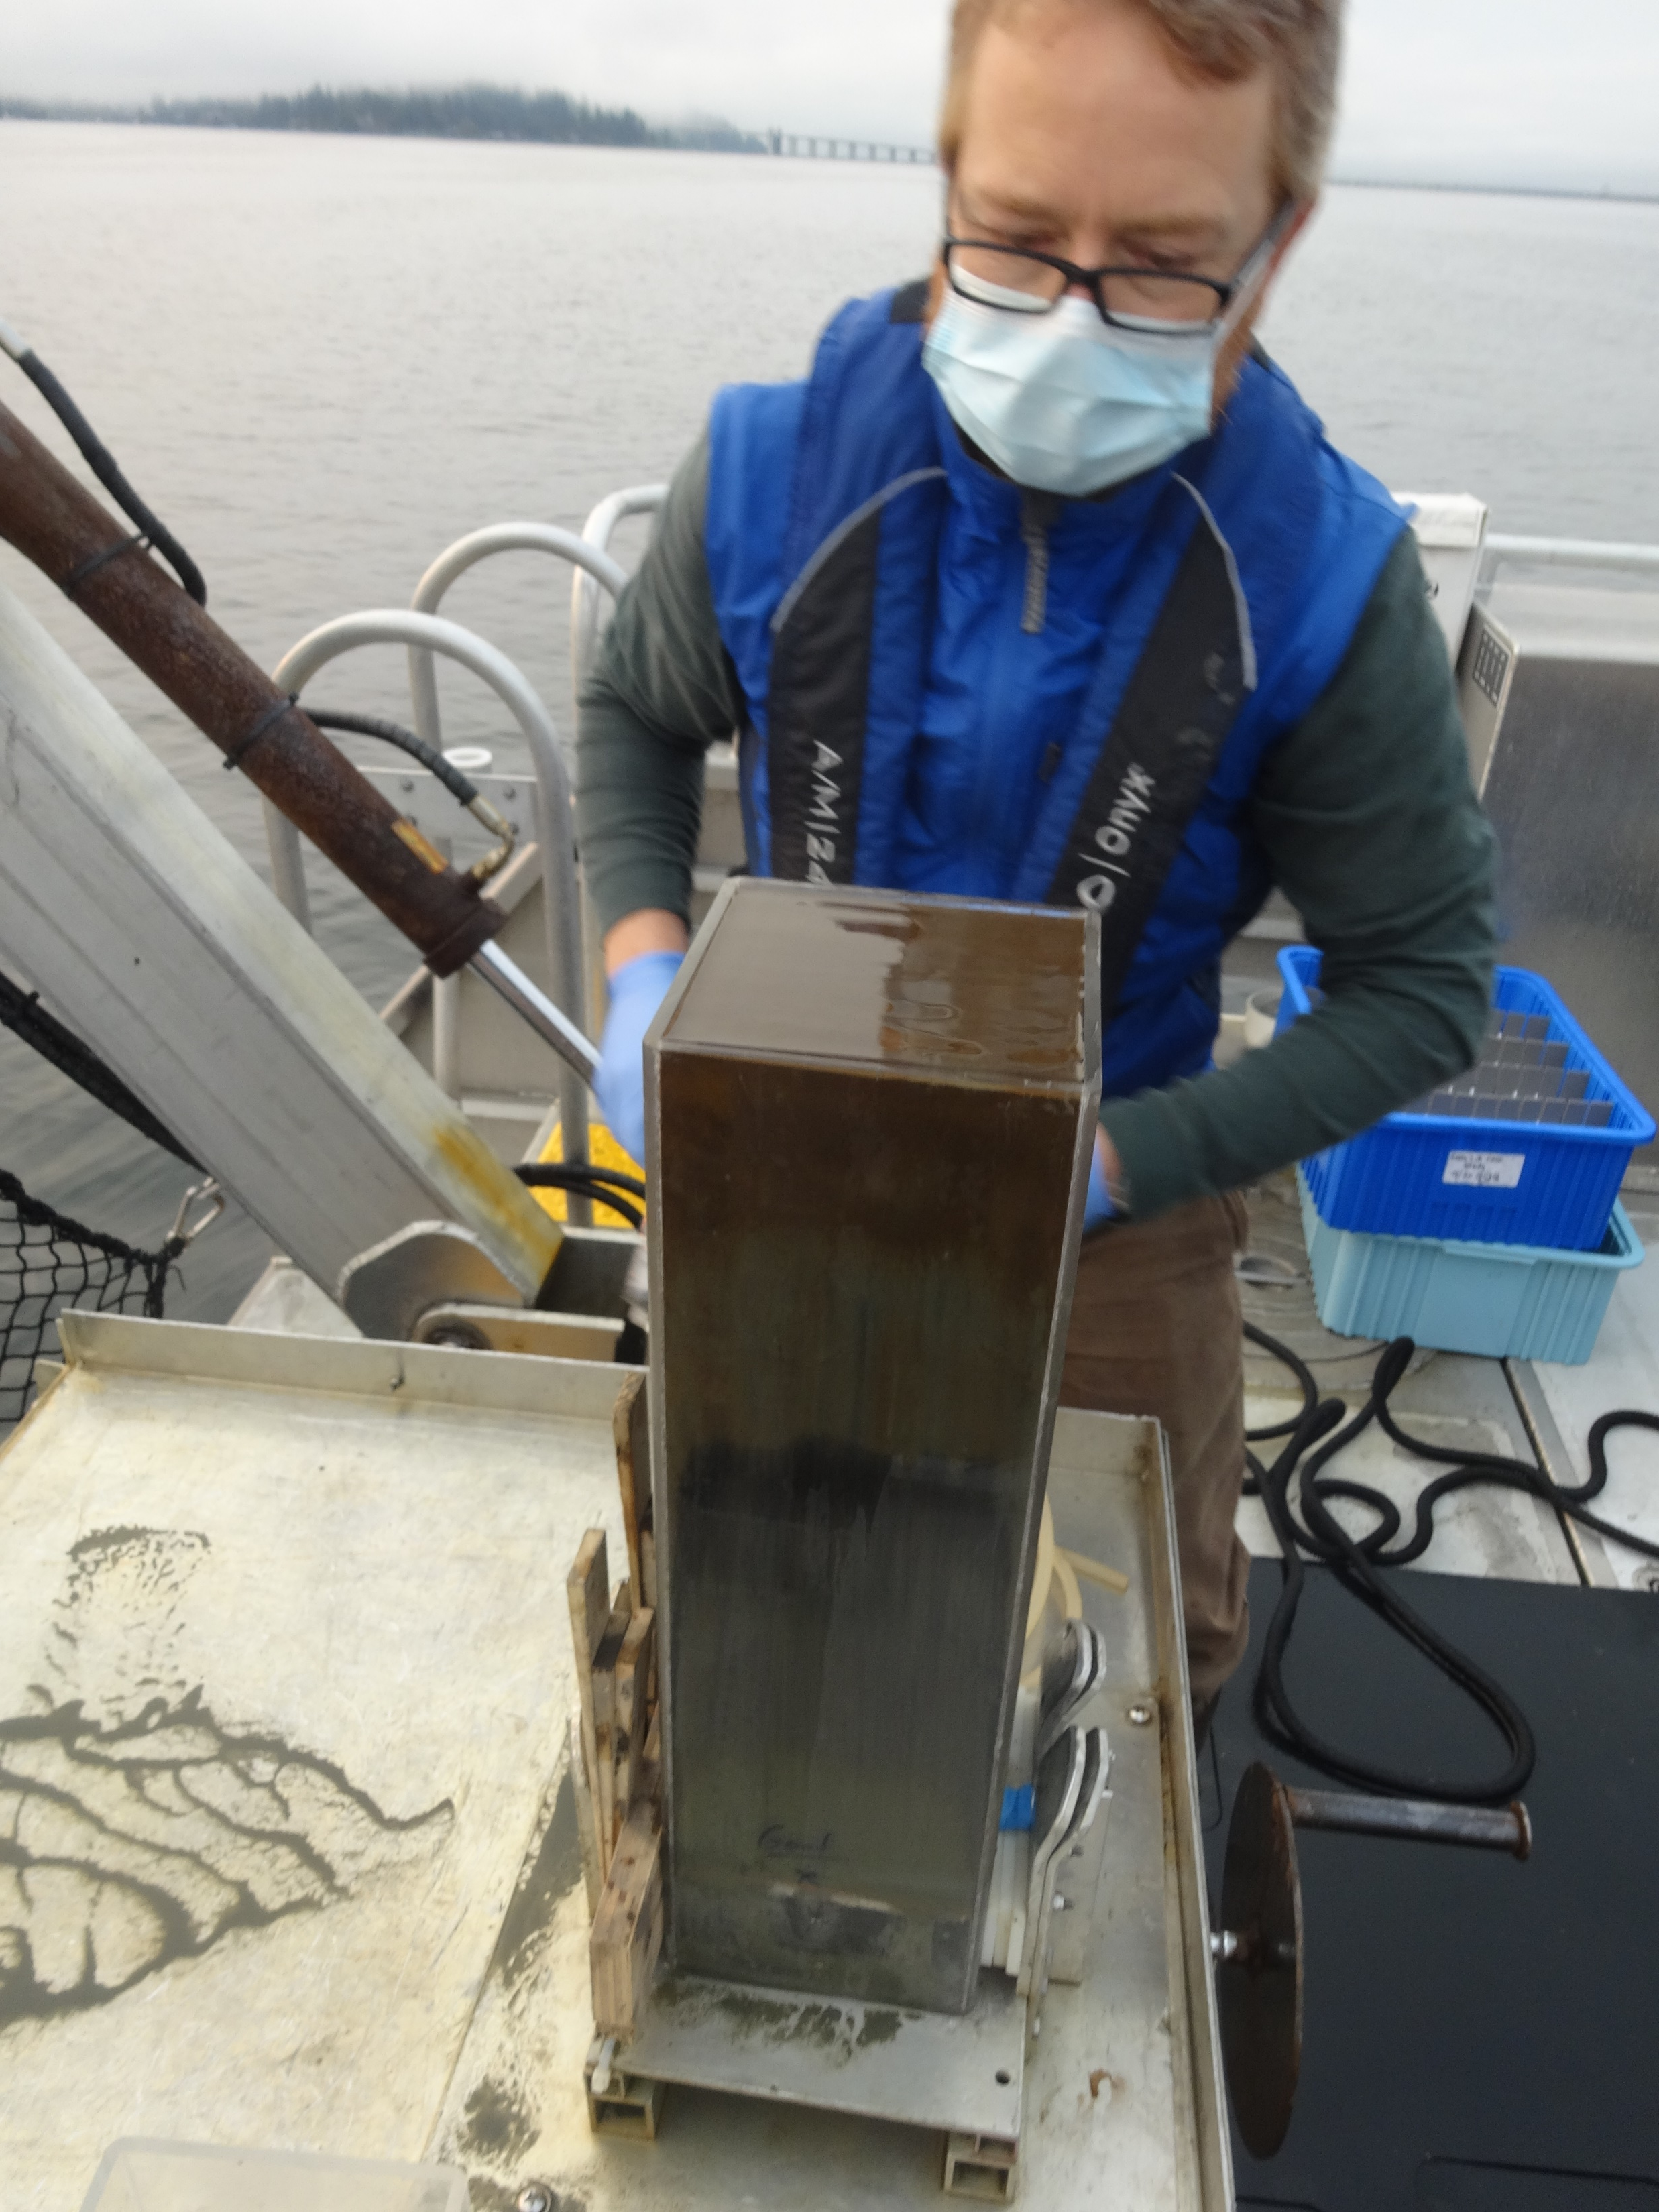
Pigments tracked eutrophication and recovery period
1975
1951
Alloxanthin
Diatoxanthin
Lutein
Myxoxanthophyll
Total Chlorophyll a
Constrained cluster analysis
Pigment concentration (µg/g organic matter)
Notes:
Here I’m showing you a graph of pigment concentrations with depth and time. A time-ordered cluster analysis of pigment concentrations identified three zones that captured the period of peak wastewater input and recovery (~1951-1975). Pigments that best captured this period are highlighted: Alloxanthin – a marker pigment for cryptophytes, Diatoxanthin – a marker pigment for diatoms, Lutein = green algae, Myxoxanthophyll = colonial and filamentous cyanobacteria, Total Chlorophyll a = total algae

Slide 13
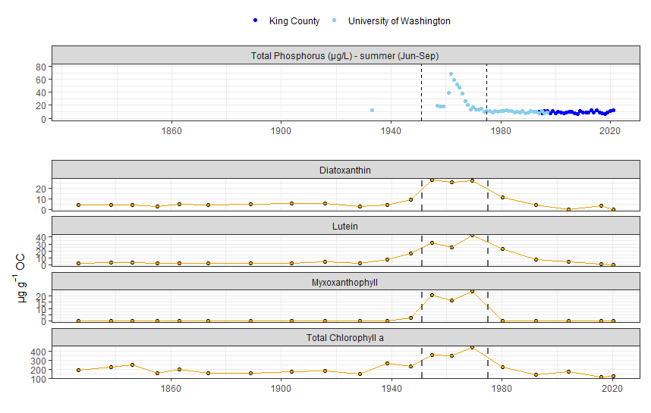
Diatoms
Greens
Blue-greens
Total algae
Notes:
Here we’re showing you a subset of the sediment pigment data and comparing it to long-term summer (Jun-Sep) average lake surface TP data in a more traditional trend plot with time on the x axis. You can see the clear response of the sediment pigments in response to increasing and then decreasing lake phosphorus inputs.
Note removal of King County 1993 data and additional 1933 data point.
Diatoxanthin = diatoms, Lutein = green algae, Myxoxanthophyll = colonial and filamentous cyanobacteria, Total Chlorophyll a = total algae

Slide 14
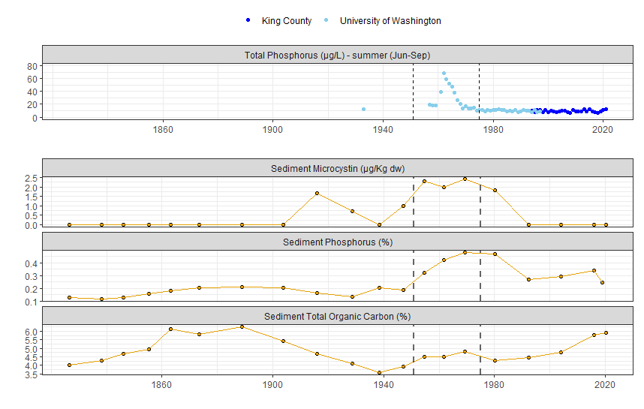
Notes:
Here we’re comparing the levels of the algal toxin microcystin in sediment (measured by an ELISA test or enzyme immunoassay), sediment phosphorus, and sediment organic carbon to long-term summer surface TP data.
Sediment microcystin and sediment phosphorus tracked the effects of eutrophication and recovery fairly closely, but sediment organic carbon did not. Sediment organic carbon was influenced more by terrestrial inputs from logging prior to 1900 and less so by later wastewater inputs.

Slide 15
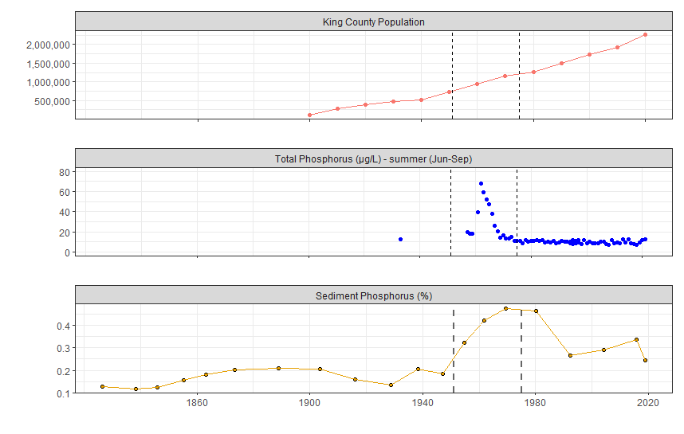
Notes:
Here we’re focusing a bit more on the sediment phosphorus data.
Sediment phosphorus data indicate that current phosphorus inputs to the lake are higher than pre-development conditions or even period of extensive deforestation. However, recent watershed phosphorus inputs appear to be rather stable considering a doubling of the regional population since the peak of wastewater inputs in the 1960s.

Slide 16
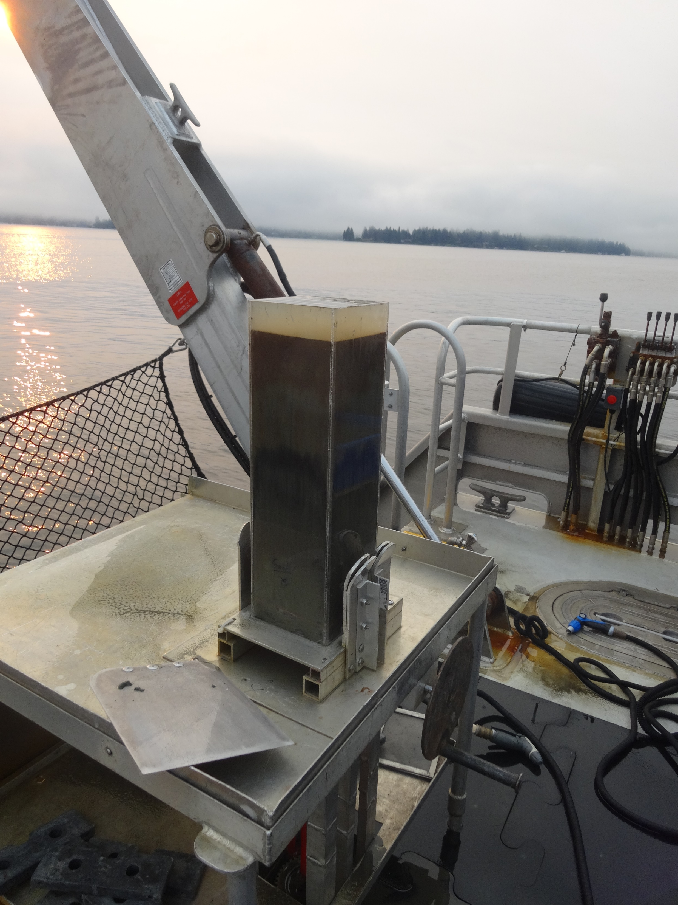
Answer?
Multiple sediment proxies of lake nutrients and algal production tracked the known history of phosphorus inputs to Lake Washington.
Notes:
Oh, there was a question we posed at the beginning. [repeat paraphrased question] An answer might be: read answer
To paraphrase Dr. W.T. Edmondson who led much of the pioneering Lake Washington eutrophication studies…” …as this (sediment) record continues to develop it can be consulted whenever needed.”

Slide 17
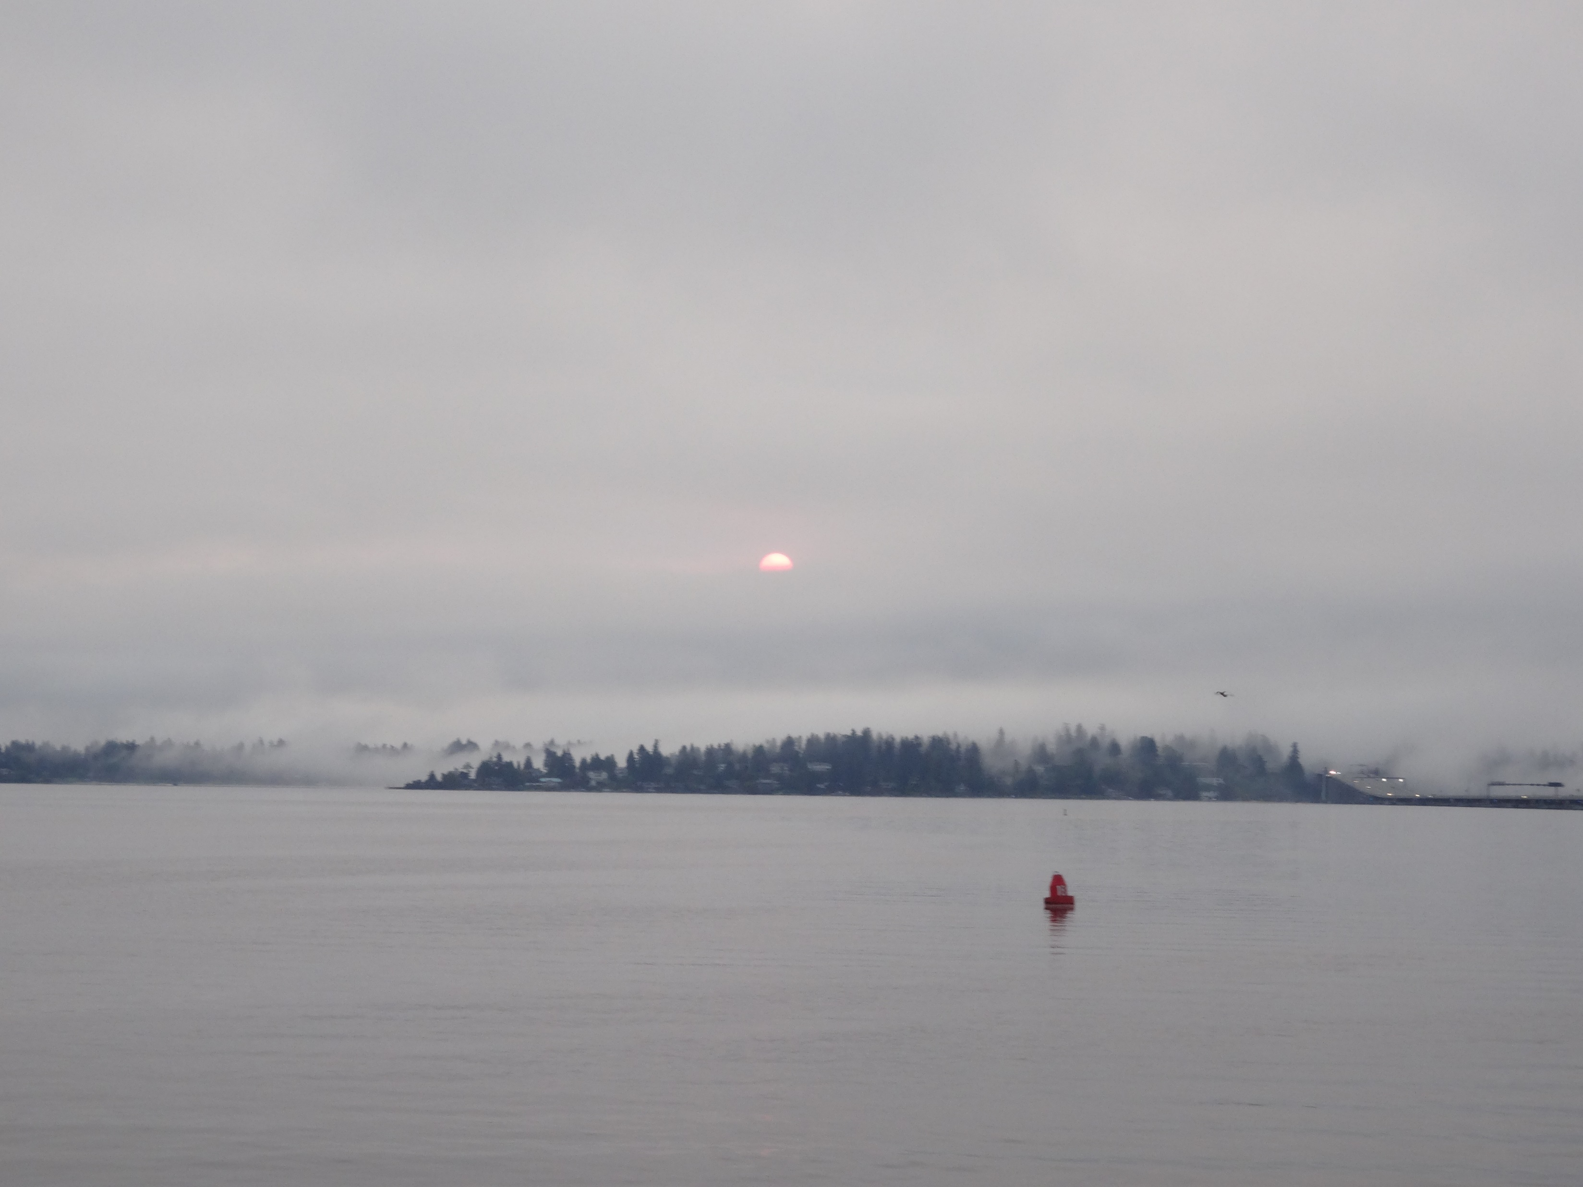
Thanks for your attention!
Acknowledgements
King County Field Services Unit (Bob Kruger)
King County Laboratory (Elizabeth Frame, Brian Prosch, Ellen Sisk, Fran Sweeney)
Science Museum of Minnesota (Dan Engstrom, Adam Heathcoate)
University of Alberta (Rolf Vinebrooke)
Washington State University (Ben Harlow)
Centro de Investigación en Matemáticas (Marco A. Aquino-Lopez)

Slide 18
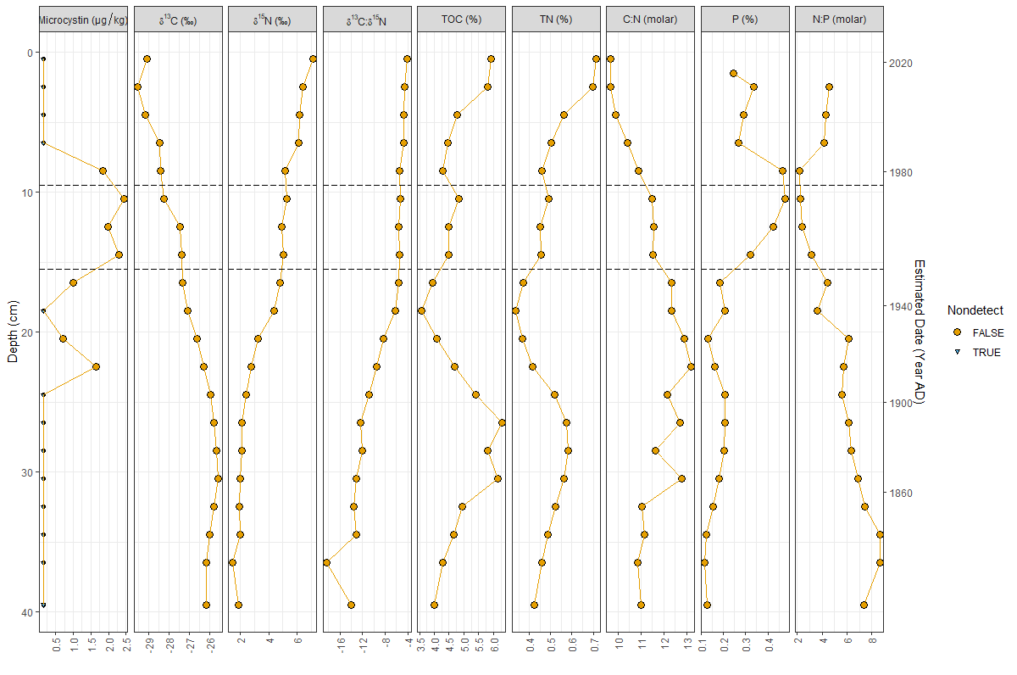

Slide 19
